Slide 1
Lecture HNF Clean Room
What should I know about the clean room?
| Jürgen Moers

Slide 2
Helmholtz Nano Facility
A Good Advice
HNF
Clean Room
Clean Room Classes
Clean Room Suit
Dos and Don´ts
Clean Room Rules
Bringing Items In and Out
Wet Benches
Transport of Chemicals
Emergency
Skin Protection
Pregnancy
Emergency Exit
Fire Alert
Meeting Point
Clean Room Alerts
Main Alert Summary
Sources of Danger
Hazard Symbols
Safety Signs
Mandatory Signs
Red Carding
| Wolfgang Albrecht

Slide 3
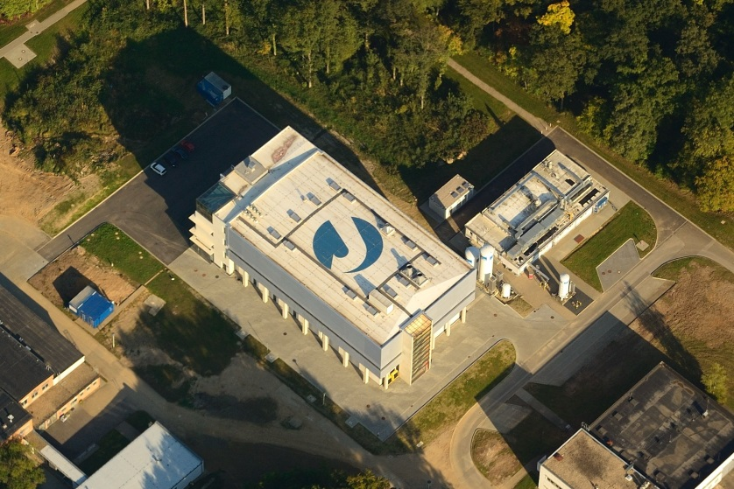
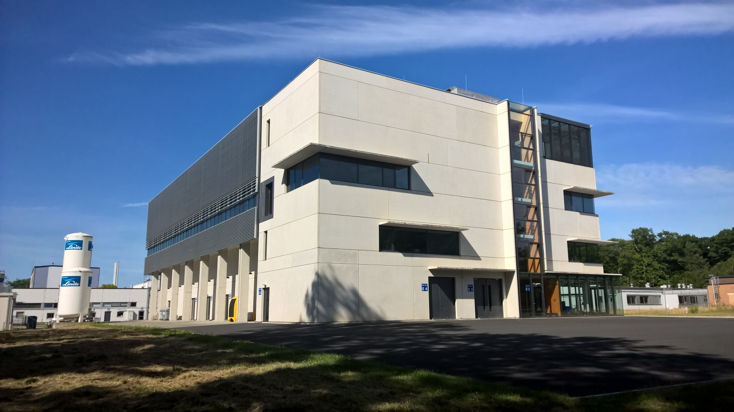
User-Zentrum
User Facility
HNF 1

Slide 4
A Good Advice
In the clean room you will be confronted with a lot of rules. That may be annoying but is intended solely to your safety.
You come in contact with toxic, corrosive and carcinogenic chemicals. Many chemicals will be very effective. A small moment of inattention you do not remember, may lead to illness later.
Therefore, the most important skills you need in clean room are discipline and diligence. In addition to the safety aspect of these two features it leads also directly to a reproducible technology. Only when you have all processes under control and are able to work reproducibly, you will succeed in technology.
Be aware of what you are doing!
What do I care?
You are obliged by German law to render first aid!
Although you are certainly not familiar with all equipment, you might be forced to give aid after an accident.
You should know how to give aid and minimize the risks for you.

Slide 5
It is no excuse to say:
„I did not know.....“

Slide 6
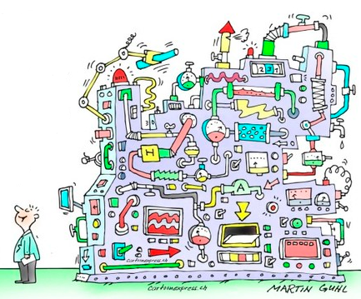
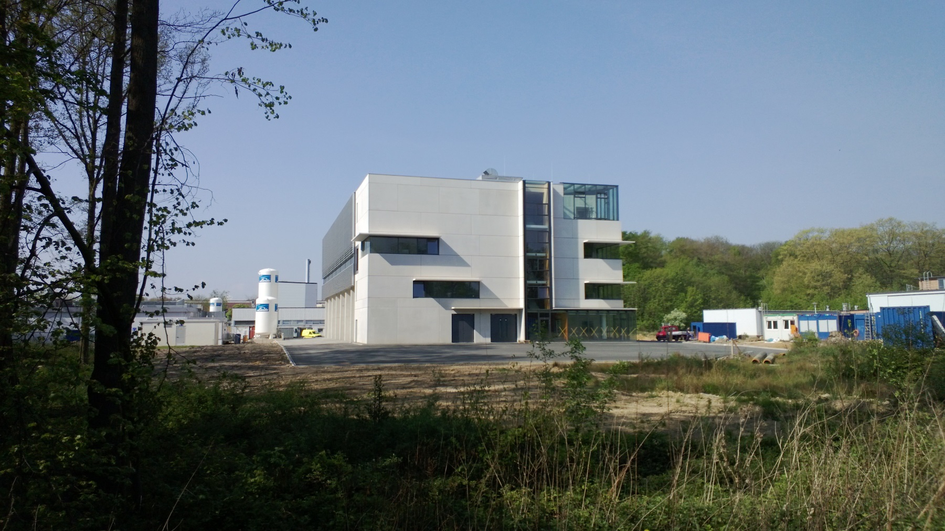

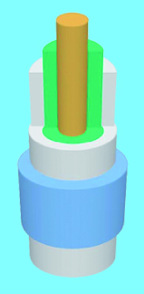
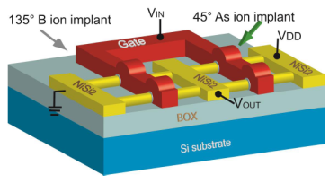
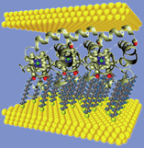
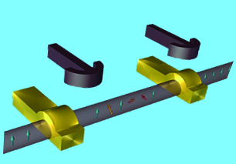
2. What is HNF?
Building + Clean room + Equipment + Technology
= HNF
HNF
User

Slide 7
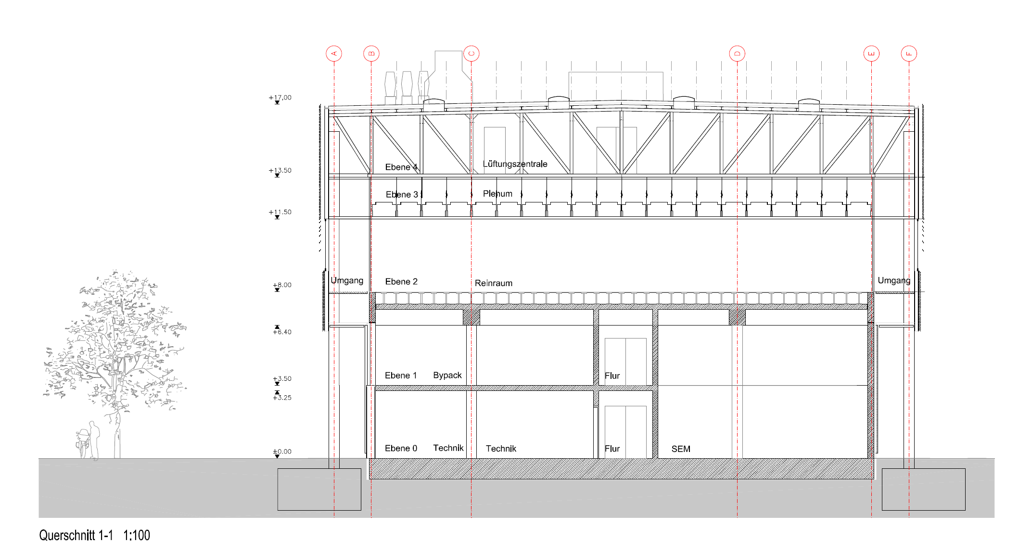
Gebäude - Building
Circulating air: 500.000m3/h
Fresh air conditioning: 100.000 m3/h
Clean air supply
Reinraum / Clean room
ISO 2 - 4
8 m
Media supply
basement
Bypack: Pumpen, Scrubber
gasschrämke
Technik
Gasschränke, DI-Wasser,
Entsorgung
Nanocluster
Gound floor and clean room are oscillation decoupled

Slide 8
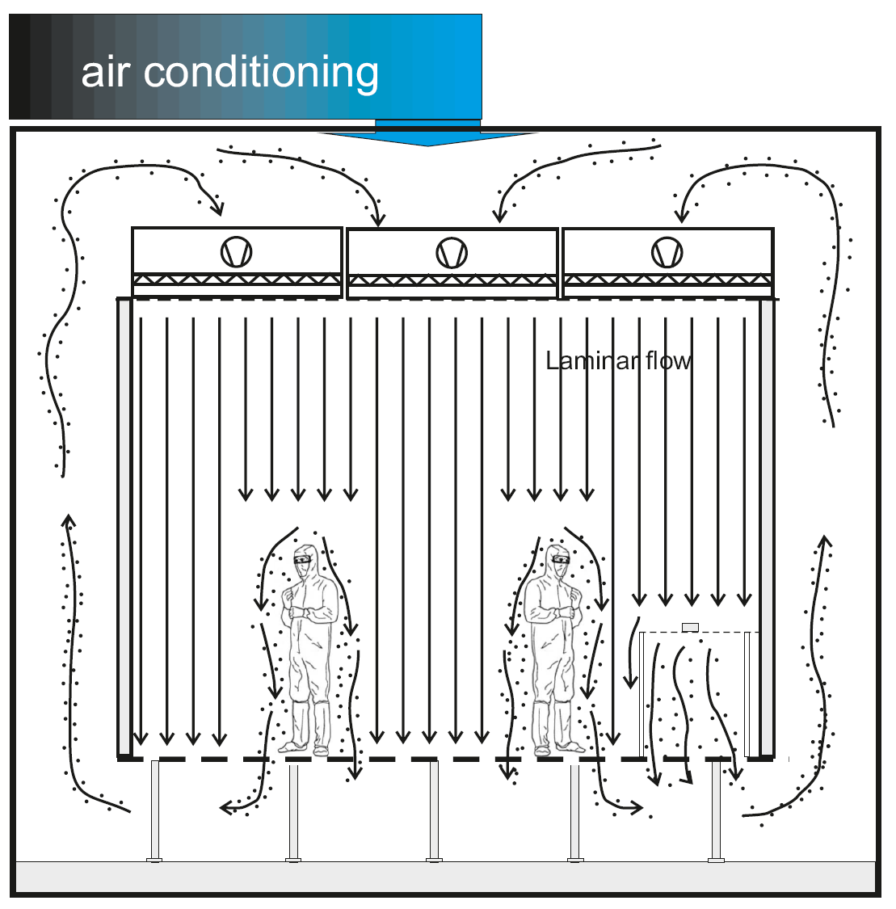
3. Clean Room
Factors:
Room temperature
Humidity
Particles
Air volocity
Vibrations
The task of a clean room is to push away the particles from you and your samples.

Slide 9
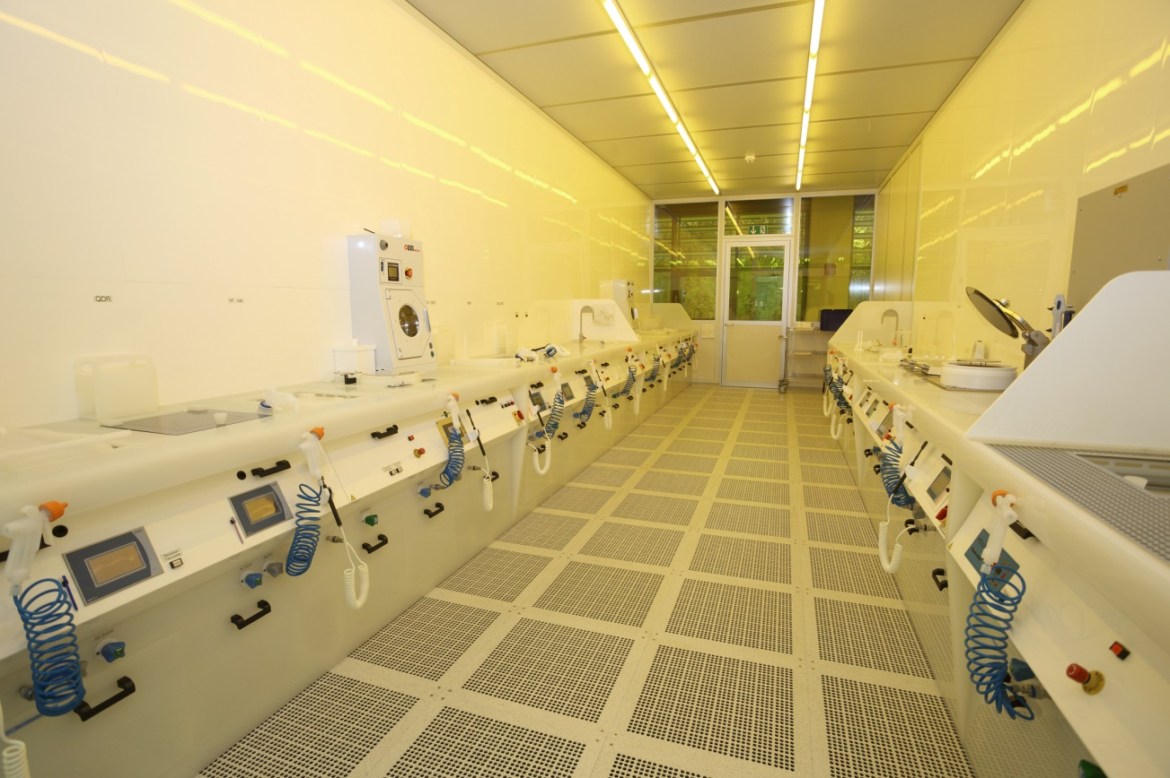
3. Clean Room
Air conditioning
Plenum
Waste air
Double floor

Slide 10

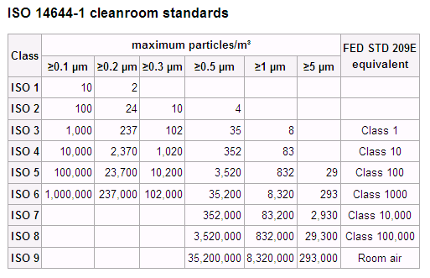
Reinraumklassen
4. Clean Room Class
You are the greatest source
of particles in the clean room!
HNF clean room classes
without a person present:
Wet bench area: ISO 1
Mask aligner: ISO 1
Remainder: ISO 2
Grey room: ISO 3

Slide 11
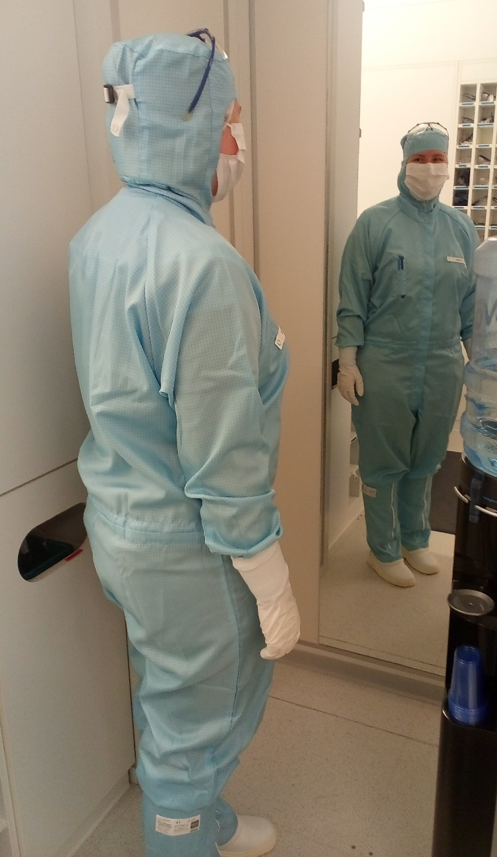
5. Clean Room Suit
You are the greatest source
of particles in the clean room
You have to wear a clean room suit!
The clean room suit protects the clean room against you
… and not you against the clean room.

Slide 12


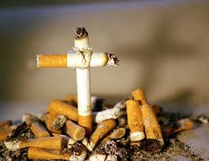

5. Before putting on cleanroom gawn, be sure
you don´t wear woolen clothing (particles!!!!)
you don´t wear jewelry (will destroy cleanroom gown)
you haven´t smoked for three hour (particles!!!!!!!!!!)
Don´t use head phones or ear pods!
You can´t hear alarms

Slide 13
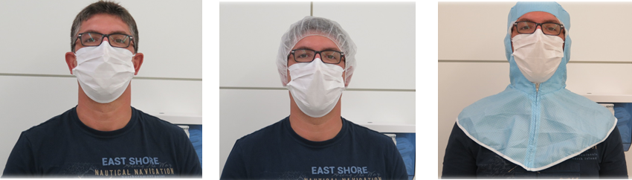
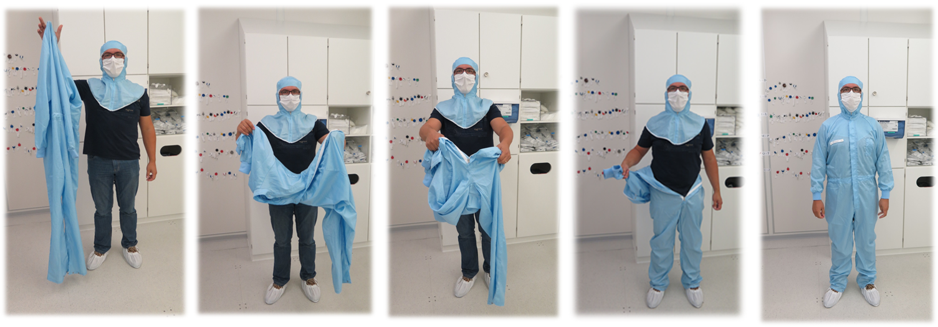
5. How do I put on the Clean Room Suit?
1. Surgical mask
2. Hair cover
3. Hood
4. Dressing:
When putting on the cleanroom suit, please touch the floor as little as possible! Try to touch the outside of the cleanroom suit as little as possible. Keep your distance from the other overalls!

Slide 14
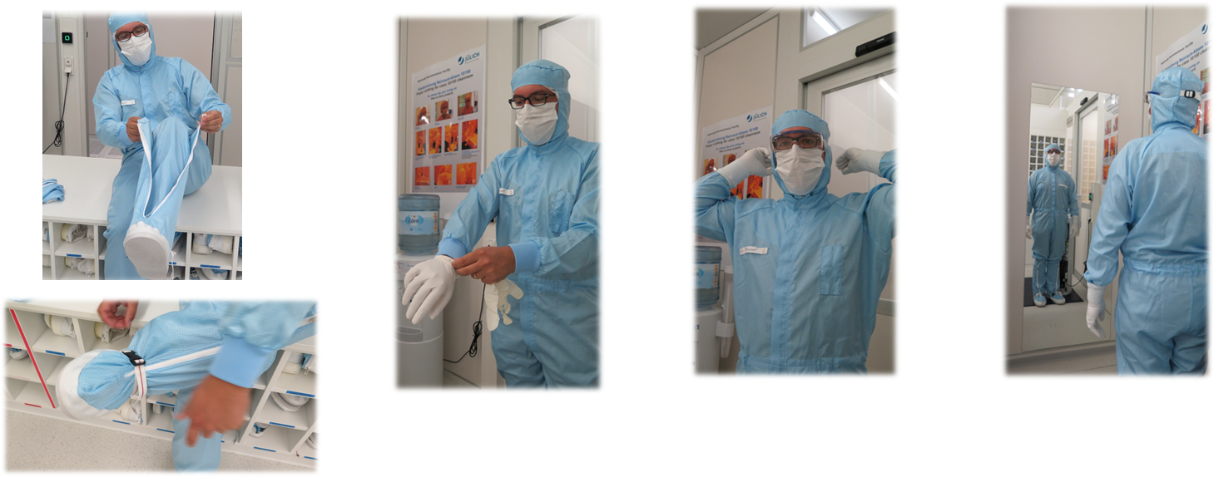
5. How Do I Put On the Clean Room Suit?
5. Sit over:
Put on shoes and
sit over:
buckle inward
Only sit with clean room suit on the sit over!
6. Gloves:
Touch outside as little as possible with your fingers.
Pull the gloves over the cuff.
7. Protection goggles
8. Last check in the mirror

Slide 15


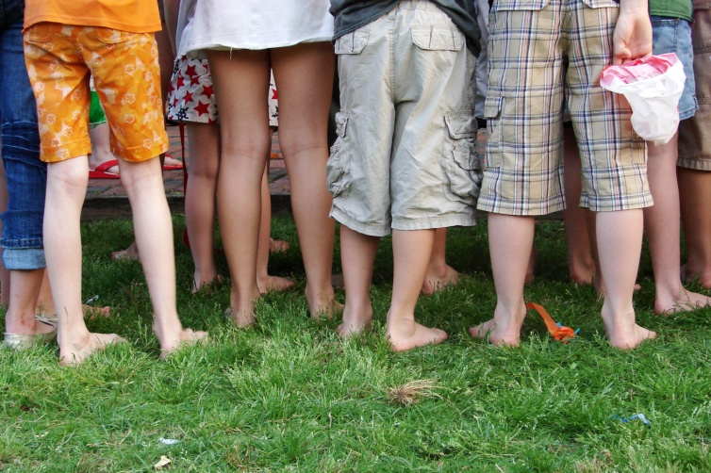
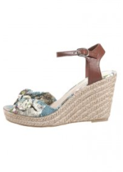
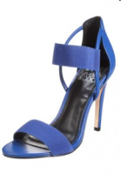

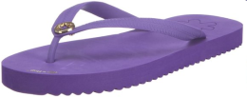

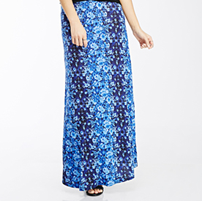


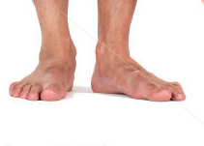

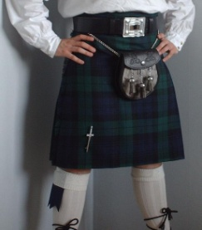
6. Dos and Don´ts at cleanroom
To avoid particles and
destruction of the
clean room suit and gloves:
no head phones/ear pods
no jewelry
no shorts and skirts
no high heels
no flipflops
no heavy footwear
no hair gel
no makeup
no pullover
no sandals
no weapons

Slide 16





6. Dos and Don´ts
Beards: You need a special hood, ask us!
Users' phones and tablets: only wrapped in foil and sealed
Generally not allowed on wet benches!
You emit particles, if you
walk , stand, move
move your arms
move your hands
speak to colleagues
….
Move and walk slowly – Avoid unnescessary movements

Slide 17
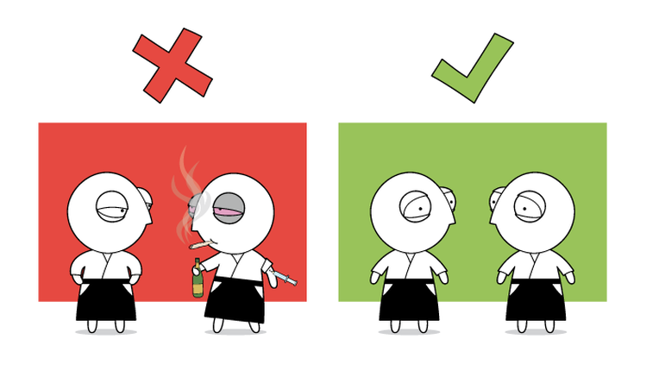
6. Dos and Don´ts
No member or guest of Forschungszentrum Jülich is allowed to work under the influence of alcohol or other drugs and thereby endanger himself or the safety of other employees. The drinking of spirits on the premises is not allowed!

Slide 18
7. Clean Room Rules
Always ask staff when uncertain.
Use of equipment only after training by cleanroom personnel.
Only working with booking.
Follow the operating instructions / material safety data sheet (MSDS).
Follow the safety precautions.
Label taken chemicals (chemical, user, date, phone-nr.)
Leave your workspace clean and dry (check by pH-measurement).
Do not work alone in the cleanroom (buddy rule).
Do not touch your skin (in special your face).
PSE (personal safety equipment) is only allowed in the wet bench area.
You must have the goggle with you in the clean room and you have to wear them in the wet bench area.
Do not lean on equipment.
Do not touch buildings hardware or wafer loading areas.
Stop working, when getting tried.
No rush!

Slide 19
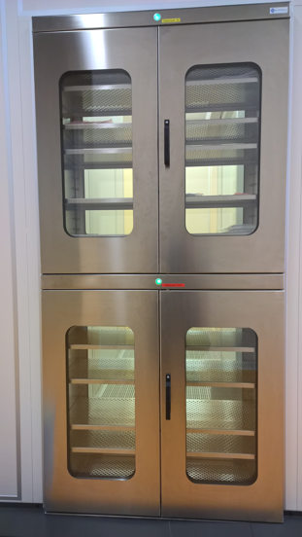
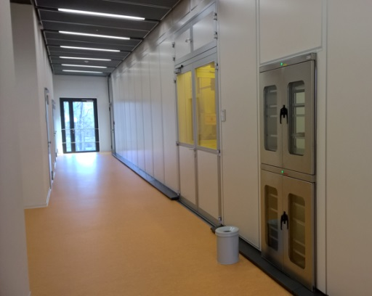
8. Bringing Items In and Out
Everything should be sealed in foil, or double sealed.
Use zip-locked bags or plastic foil.
Once cleaned and sealed inside a clean room items should not be opened until inside another clean room.
Remove the first seal and put item in the input of the sample lock.
Enter the clean room, take the items out and open the second seal.
Standard clean and degreased is required for all new items entering the clean room.
Don´t touch the inner foil with your bare fingers!
sample input
Bild Probenschleuse
sample output

Slide 20
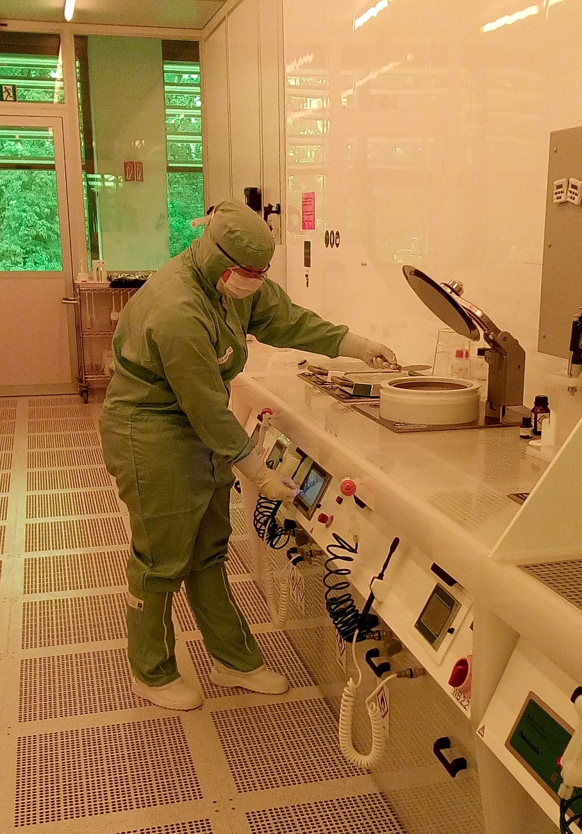
9. Wet Benches
You want to handle your samples:
  cleaning
  spin on resist
  bake out and developing resist
  etching samples
  etc.
You need a safe environment for processing your samples with acids, bases, solvents.
Such an environment is a wet bench, a kind of fume hood in the clean room.
You have to follow some rules working on a wet bench and must understand the function.
With entering the room you need to wear safety goggles.

Slide 21
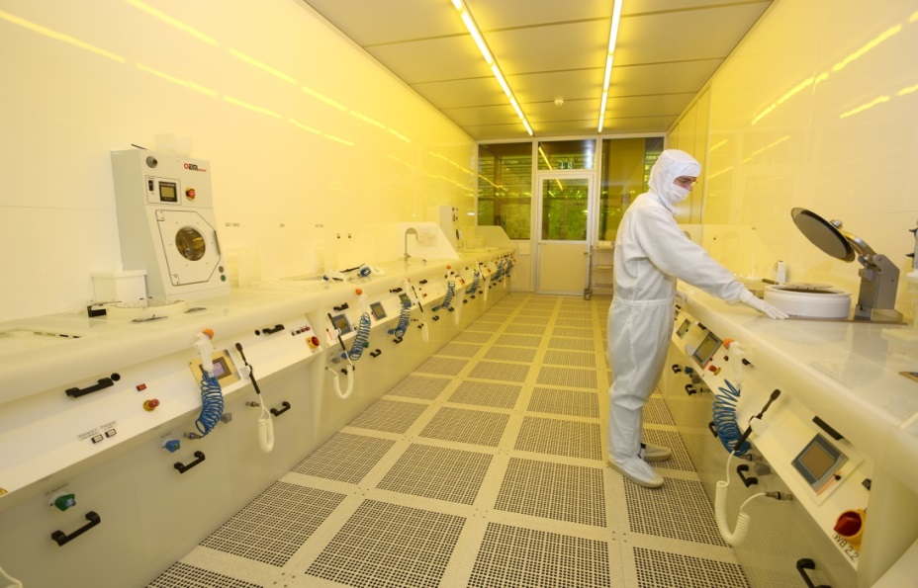
9. Wet Benches
Never work alone in the wet bench rooms !
In case of an accident, you need a second person. If you work alone in a wet bench room, you do so at your own risk.
For reasons of occupational safety, persons with a body size below 1.60 m (5 ft 3 in) cannot work with dangerous chemicals on the wet benches.
In the Research Center Juelich working with hazardous chemicals and materials is only permitted in the core working hours from 8 am - 4:30 pm.
“Only “superuser” with special training are allowed to work longer in the cleanroom. But never alone!”

Slide 22
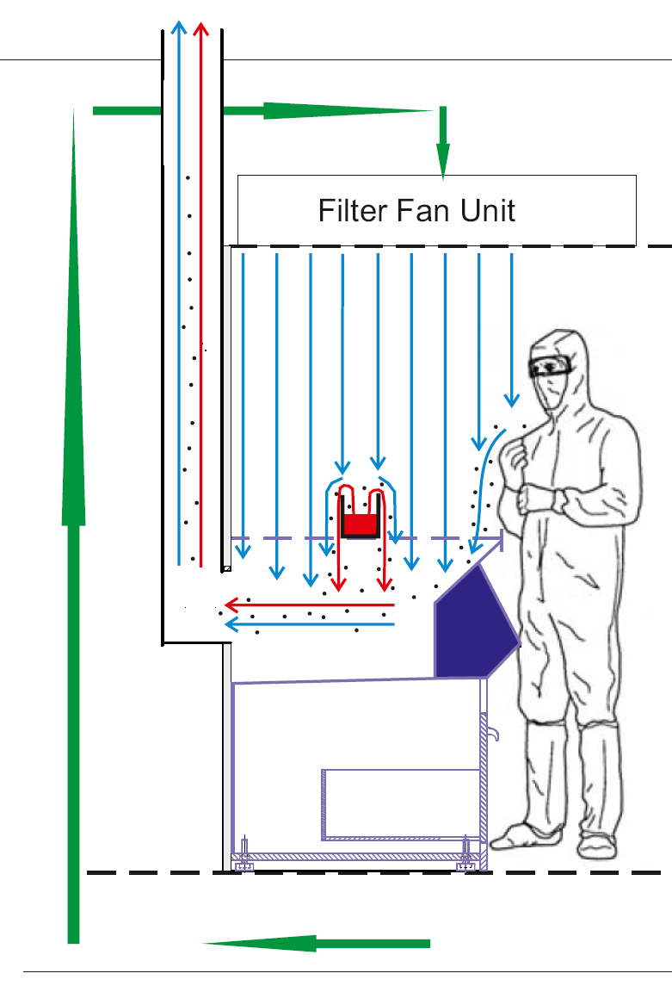


9 Wet Benches
The working surface of the wet bench ist perforated.
Exhaust air supplies an underpressure in the wet bench.
Particles and chemical fumes are transported into the bench by the laminar flow and disposed of by the exhaust air.
Lable all used beakers correctly with
your name,
date and
chemical inside

Slide 23
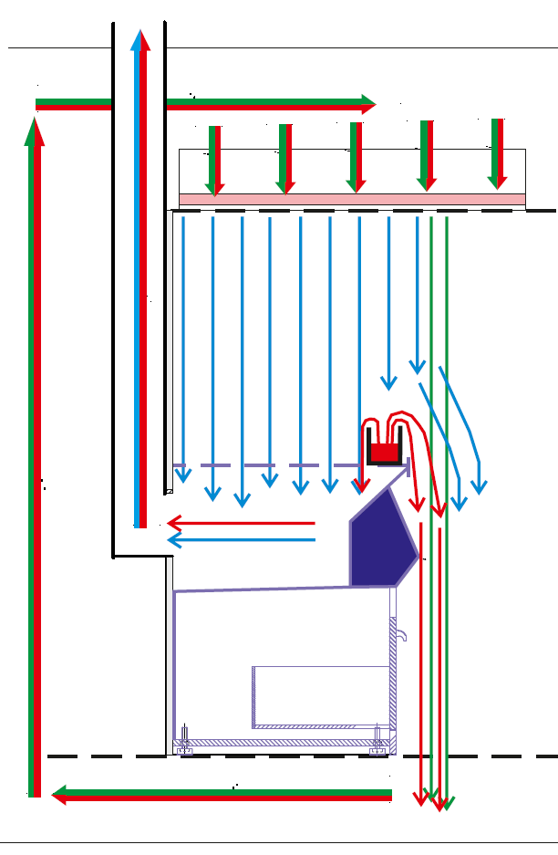

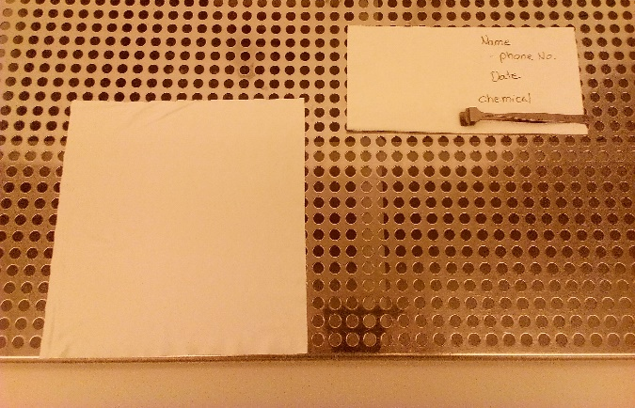

9. Wet Benches
In three cases the bench does not function and chemical fumes can leave the wet bench:
Blocking of the air stream with a beaker or a fab wipe near the front edge.
15 cm
Do not use the first 15 cm of the working space!
Do not lean over the bench!

Slide 24
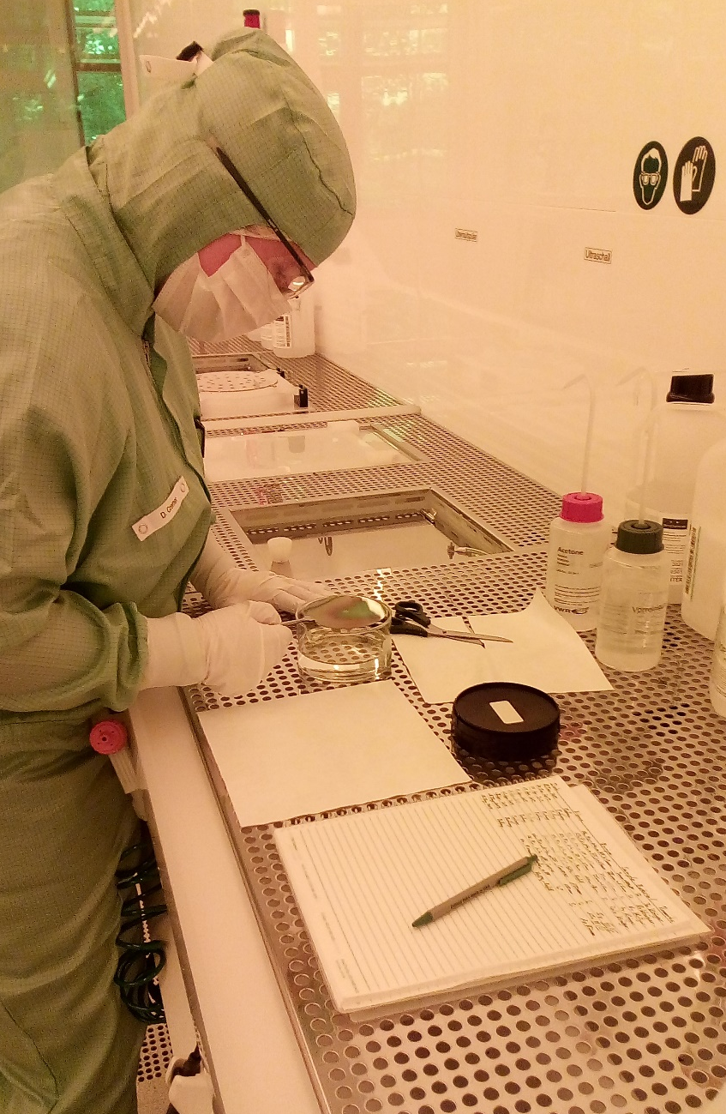
9. Wet Benches
In three cases the bench does not function and chemical fumes can leave the wet bench:
Leaning over the wet bench:
The lamina downstream is disturbed
Do not lean over the wet benches!
Quick movement along a bench leads to an underpressure behind the person. As a result, the laminar flow will be disturbed.
Do not move quickly past the wet benches!
Furthermore:
No notebooks, tablets or phones are allowed at wet benches.
Don‘t cut fab wipes.
Use the correct gloves.

Slide 25
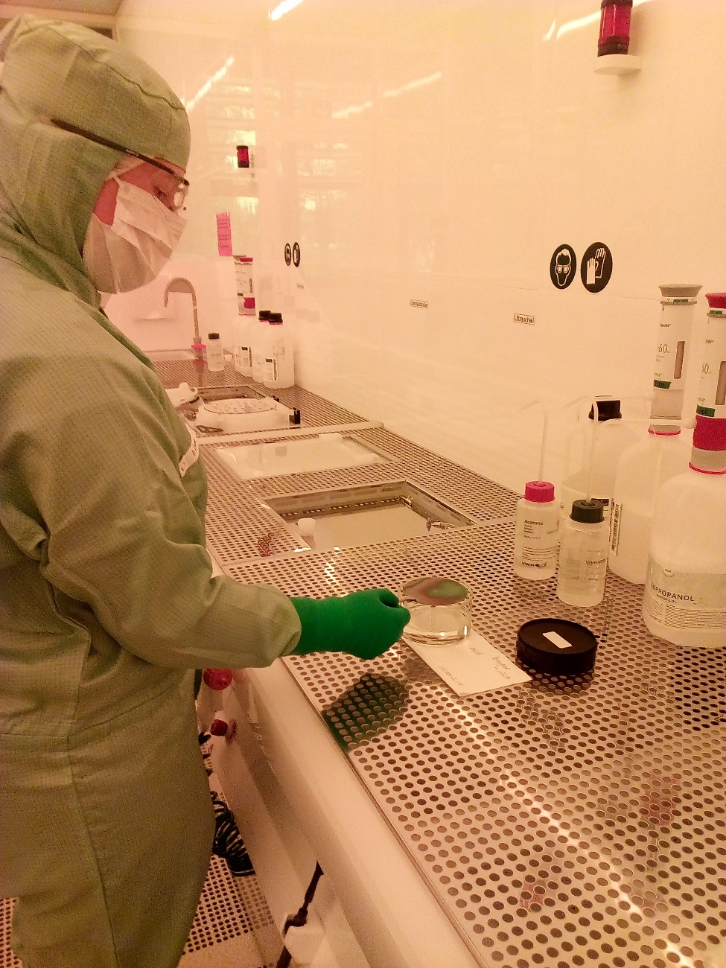
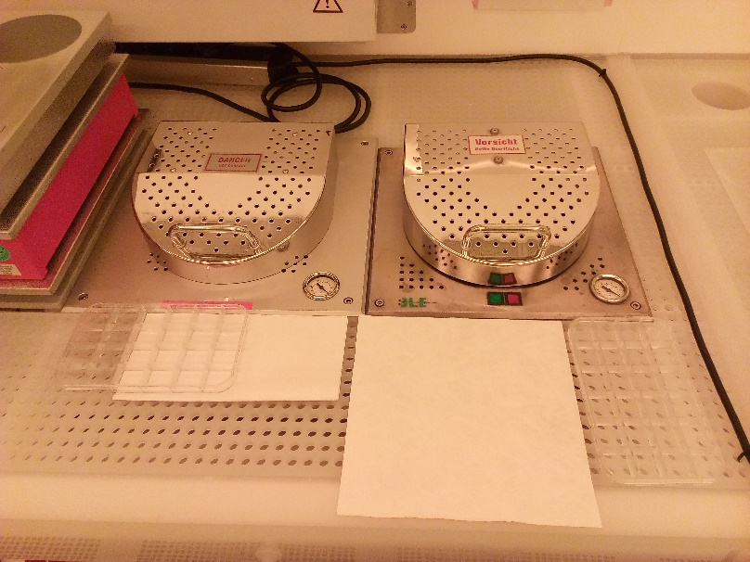
9. Wet Benches – Behaviour
How to work with less space. For example III/V wet bench:

Slide 26
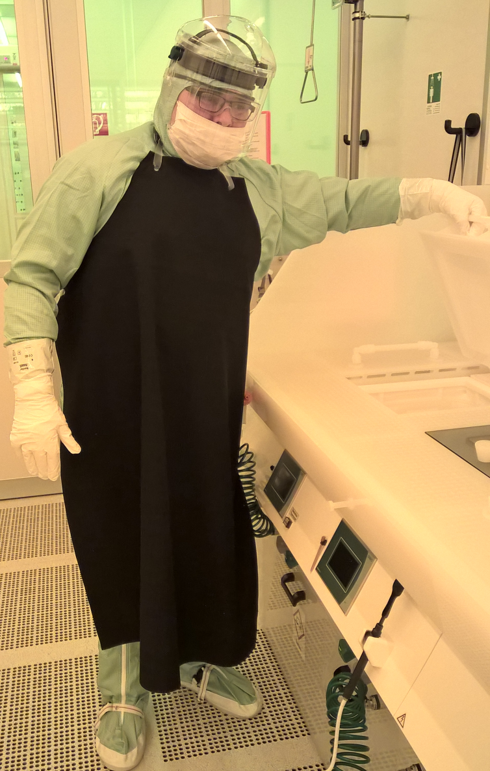
9. Wet Benches – Behaviour
Working with acids and bases:
Only with the personal safety equipment (PSE):
  face protection
  apron
  heavy safety gloves
Always use new safety gloves when starting work.
Use safety gloves of the right size.
Change safety gloves and apron if they are leaky or discolored.
Dispose of gloves after contamination.
Dispose of gloves at the end of your work session.

Slide 27
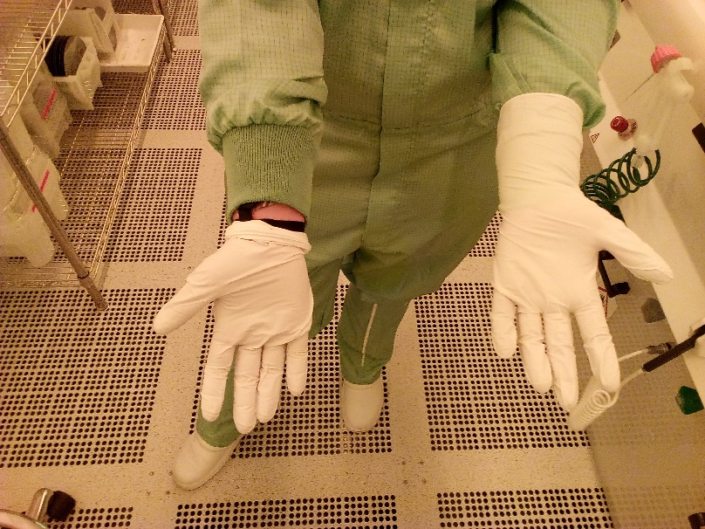
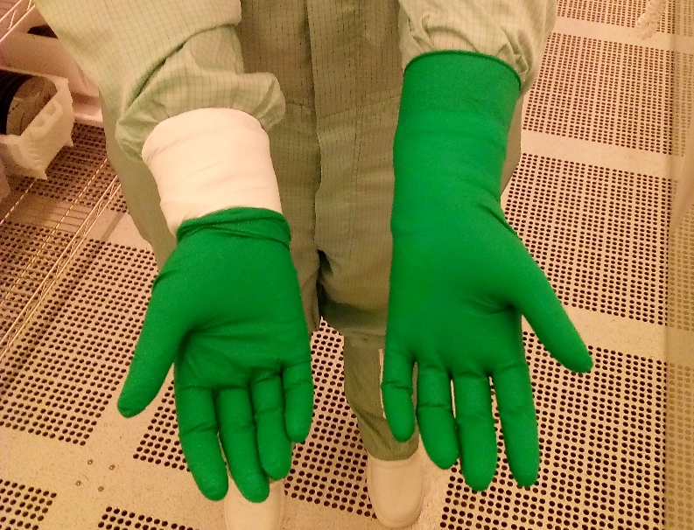
9. Wet Benches – Gloves
This are NO safety gloves!
Get sure, that you wear ALL gloves correctly. For your safety and for the cleaness of the cleanroom!
The „green“ (dermashield) safety gloves are for developer and solvent contamination and look like this.

Slide 28
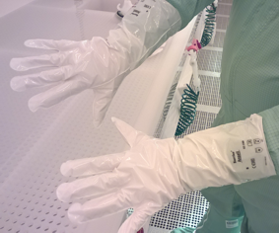
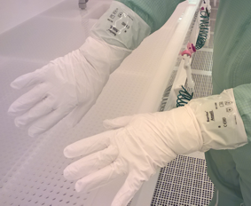
9. Wet Benches – Heavy Safety Gloves
Heavy safety gloves look like this!
The heavy safety gloves are for acids, bases and dangerouse solvents.
We recommend you to cover the heavy safety gloves with a second pair of nitrile gloves to improve the haptic/feel.

Slide 29
9. Wet Benches – Behaviour
You can wear contact lenses in the cleanroom!
Remove your PSE whenever and howsoever you leave the wet bench area!

Slide 30
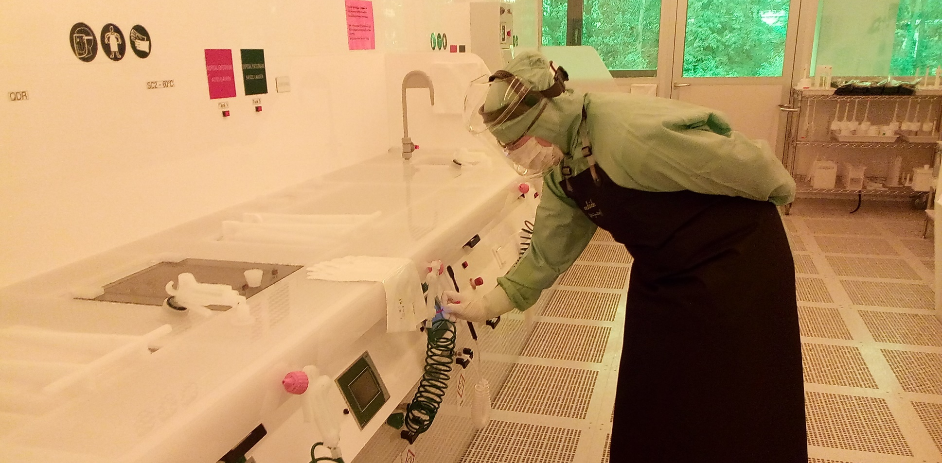
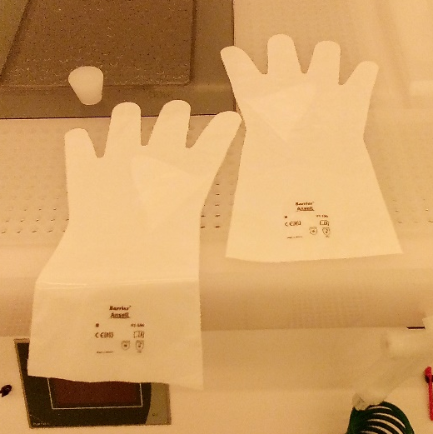
9. Wet Benches – Behaviour
Do not wear chemical heavy safety gloves while working below the desktop!
The heavy safety gloves may contaminate the controls without you noticing it.
The sleeves of the safety gloves should hang over the bench so that no contamination can reach your arm.

Slide 31
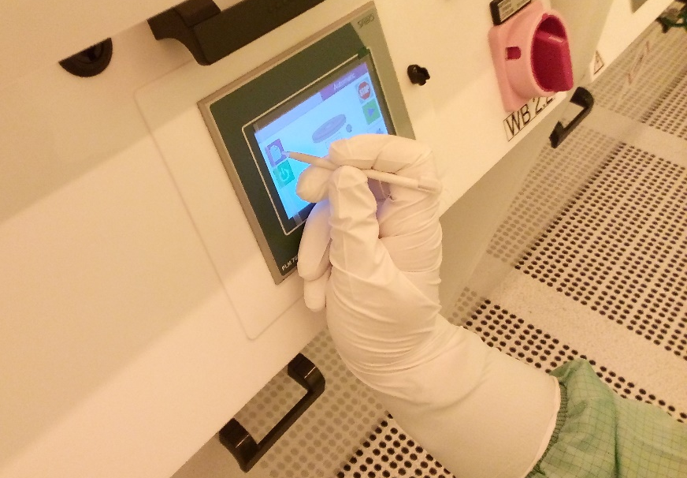
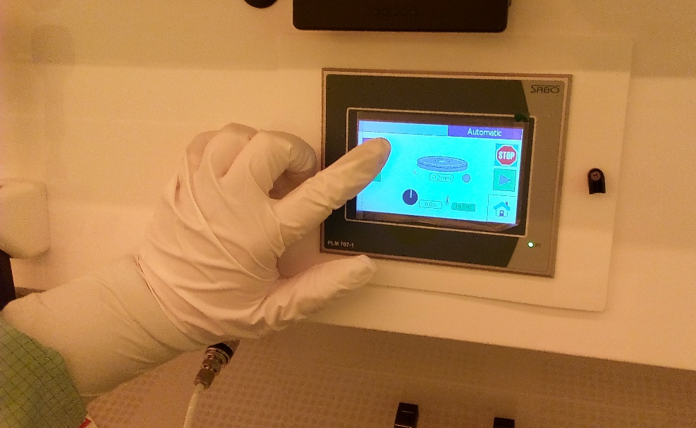
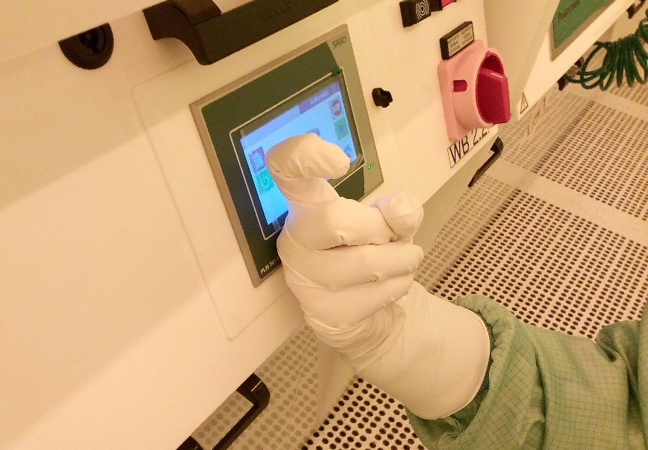
9. Wet Benches – Behaviour
Do NOT use your finger to operate on the touch display!
Use the pen or your knuckle!
That protects the display for contamination.

Slide 32
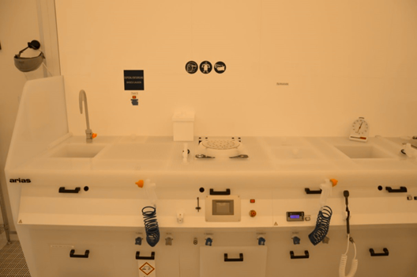
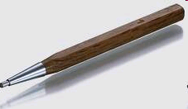
9. Wet Benches – Behaviour
Do not scribe or break substrates in the clean room except in the scriber area!
Scribe, break, or mark
with diamond pen only
in the scriber area!
The scriber area is next to the shrink-wrap maschine. It need an indroduction!

Slide 33
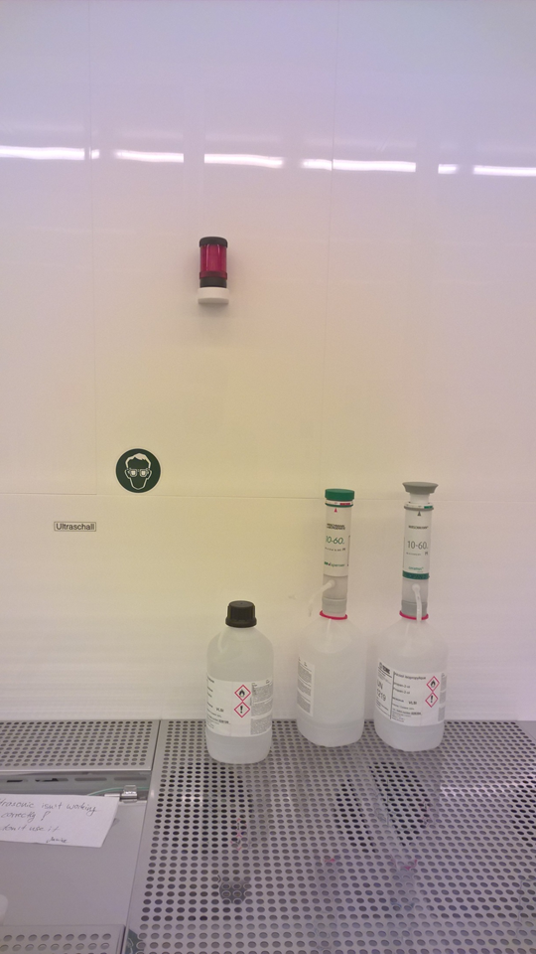
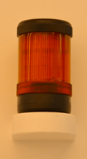
9. Wet Benches – Solvent Banks
ExTox - Sensors on Solvent Banks
Light on = Risk of Explosion
Stopp your work. Leave immediately the wet bench area and order other people in the room to do the same. Inform the clean room staff and wait until the light goes off.
Waste / exhaust air is still running (100%)

Slide 34
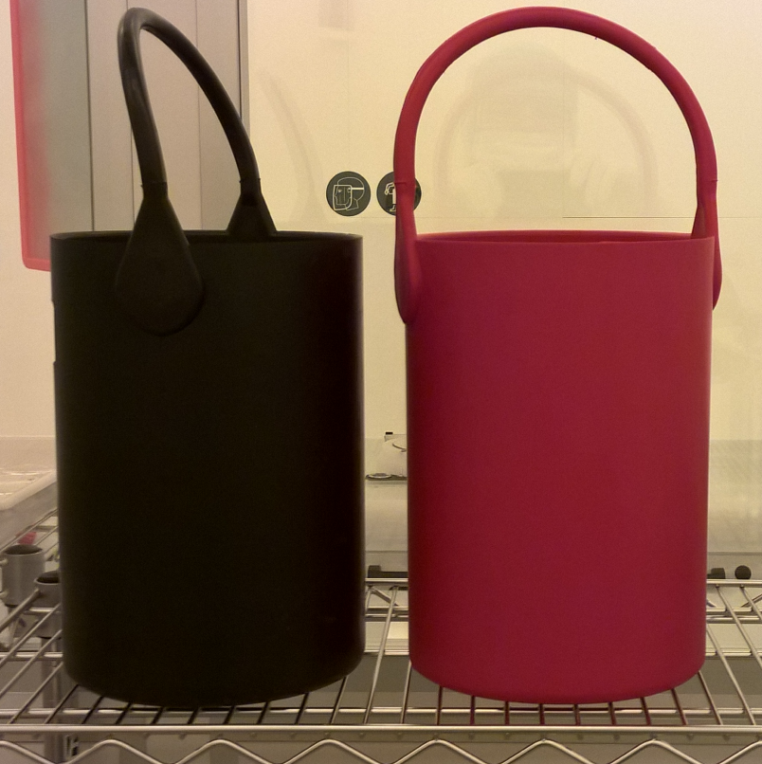
10. Transport of Chemicals
For transport of ALL chemicals use these buckets!
Also use the buckets when the bottle is empty!

Slide 35
11. Emergency
Instructions for first aid !
Content of emergency call!
keep calm
overcome your fright
think before you act
protect yourself
(Gloves? Apron? Shield?)
prevent further damage
secure scene of accident
fetch help
call 77
do not give to eat and to drink
do not leave injured alone
Where did it happen?
  Bdlg. 2.14,
  Clean room = Room 4006,
  Second floor
What happened?
How many injured?
What type of injuries?
Who is calling?
Wait for questions!

Slide 36
11. Emergency
Any accident has to be reported immediately to the HNF Staff. Even minor accidents should be reported to the works doctor of FZJ.
Make sure that the form for reporting the accident is sent to the Department for Occupational Safety (Fachbereich Arbeitssicherheit S-A)
Typical minor accidents
Typical accidents to be reported
fall from a ladder
wounds caused by hand tools
damage to the eyes from
chemicals
road accident
cuts
stab wounds
burns
bruises

Slide 37

11. Emergency
Sicherheitsbeauftragter (Safety Officer)
Jana Brugger (j.brugger@fz-juelich.de, phone: -2846)
Nadine Teofilo da Silva (n.dasilva@fz-juelich.de , phone: - 96226)
First Aid Helpers
Most of the HNF employees are also first aid helpers. A list is displayed at cleanroom entrance and at the PPMS PC in cleanroom. Ask them for help!

Slide 38
11. Emergency
Decontamination and First Aid for Acids
Immediately remove all exposed clothing taking necessary precautions to prevent self-exposure (wear gloves) while washing all exposed areas with copious amounts of water.
While the victim is being rinsed with water, someone should call to arrange treatment by medical personnel. Call 77 and tell the dispatcher the following:
  There is a person that has been in exposed to acid and the victim is in this location.
  Please send an ambulance to transport.
Immediately washing off the acid is of primary importance!

Slide 39


12. Skin Protection
Skin softening (maceration)
The liquid-tight effect of chemical protective gloves prevents perspiration to the outside so that the skin softens with increasing wearing time and swells, causing its barrier effect to wear off. This weakens the skin’s ability to resist penetration of irritants, potentially allergenic (sensitizing) substances or infectious agents.
Clean hands and use the care products before leaving the locker room.
For instructions see -> “Hautschutzplan”

Slide 40

13. Pregnancy
In case of pregnancy:
Best wishes!
Inform us immediately!
entering wet areas is prohibited until further notice
the work with dangerous materials and chemicals is prohibited
Talk to us. We will discuss with you in which areas you can still work.

Slide 41

14. Emergency Exits
Main Entrance
stairs
The building has two stairways and is divided by two central corridors. Follow the corridors to the exit or to the stairways.
General rules:
from the inside to the outside
follow the green signs
On each floor you will find an escape and rescue plan in the stairway.
The escape plan shows:
the quickest way out
the safest way out
behavior in case of fire
behavior in case of accident
stairs

Slide 42

14. Emergency Exits Clean Room
stairs
Emergency Exit
Equipment
area
stairs
Wet
bench
area
General rules:
from the inside to the outside
Follow the green signs „Emergency Exit“
Do not block escape routes, emergency exits and fire doors. Do not place any obstacles or objects in front of emercency exits, not even momentarily.

Slide 43



15. Alert Fire Department
Press for fire alert
Press for medical rescue
You find the fire alert and fire extinguisher in every corridor at both ends
You shoud know:
Location of escape plans
Location of fire alert
Location of fire extinguishers

Slide 44

16. Meeting Point
In case of fire alert or toxic gas alert leave the building immediatly and go to the meeting point:
Foyer of the Central Library, Bdlg. 04.7
Wait inside the Central library. Only there you hear the next announcements.

Slide 45





In front of the wet bench area
17. Cleanroom Alerts
Inside of the wet bench area
Before entering the wet bench area check the signal in front
Green light = OK! Everything is alright
2. Orange light / Red Light = Waste air off.
  Do not enter the wet bench area!
Exhaust / waste Air off (0%) =
  Red blinking light + Siren
  Secure your work space
  Immediately leave the wet bench area
  Undress the bunny suit and leave the cleanroom
  Meet in front of clean room

Slide 46

Gas Alert
17. Cleanroom Alerts
Signal | Meaning | Action
Blinking yellow / orange | Alarm 1: This means that there is gas detected, but at 10% maximum tolerated work space level. | Orderly evacuation: Contact staff, secure your samples, clean up your workspace and leave clean room the normal way
Blinking red and orange + siren | Alarm 2: Toxic gas detected | Immediate evacuation: LEAVE THE HNF AT ONCE! Put the chemicals in the back. But do not bother about samples, do not bother about overall, leave the building and gather at the meeting point!

Slide 47
18. Main Alerts Summary
Fire Alert = Siren + blinking red light in the whole building
  Secure your work space
  Immediately leave the building
  Do NOT remove your bunny suit (if you are in the clean room)
  meet at the meeting point
Toxic Gas Alert (section alert for each floor) = Red and orange blinking lights + Siren
  Secure your work space
  Immediately leave the floor
  Do NOT remove your bunny suit (if you are in the clean room)
  meet at the meeting point
Exhaust Air off (Wet bench area) = Red blinking light + Siren
  Secure your work space
  Immediately leave the wet bench area
  Undress the bunny suit and leave the clean room the normal way
  meet in front of the HNF

Slide 48


19. Sources of Danger in Clean Room
EM fields / RF
In case of
cardiac stimulator:
Talk to us!
Reactive Ion Etcher
PECVD
…

Slide 49




19. Sources of Danger in Clean Room
Follow the operating instructions (“Betriebsanweisung”)
and material safety data sheets (MSDS)

Slide 50


19. Sources of Danger in Clean Room
Example: Spectroscopic Ellipsometer SE800
Hazards:
short wavelength light
movable parts
In case of lamp rupture:
switch off main power,
leave analysis room and
contact staff
Follow “Betriebsanweisung”
Attention:
After sample adjustment, microscope has to be put to middle position (“sample height”)
Else:
Repair costs ~4000€

Slide 51

19. Sources of Danger in Clean Room
Example: Mask Aligner I-IV – (SUSS MA6 & SUSS MA8gen3)
Hazard: | Prevention:
short wavelength light
ozone
Hg-lamp rupture | switch off main power, evacuate lithography room, call “77” (point to Hg!) and contact staff
movable parts: microscope table (MA 1 & 2) lighthouse (MA 3 & 4) | beep announces movement be careful ☺
hot surfaces | don‘t touch the lamp housing
 | follow “Betriebsanweisung”

Slide 52



20. Hazard Symbols
Pictogram | Symbol | Effect | Safety
 | Exploding Bomb GHS01 | Explosion triggered by fire, impact, friction, heat; hazard by fire, atmospheric pressure, splinters. | Do not rub or jolt, avoid fire, sparks and any heat build-up.
 | Flame GHS02 | Substances are inflammable; liquids form explosive mixtures with air; form inflammable gases with water or are self-igniting. | Keep away from open fire and sources of heat; close containers tightly; keep in a place safe from fire.
 | Flame over Circle GHS03 | Acting oxidizing and intensifying fire. Mixing with inflammable substances results in explosive mixtures. | Keep away from inflammable substances and do not mix with them; store in a clean place.

Slide 53



20. Pictograms for Hazardous Materials
Pictogram | Symbol | Effect | Safety
 | Gas Cylinder GHS04 | Gas cylinders under pressure may explode when heated; cryogenic gases generate serious cold injuries. | Do not rub or jolt, avoid fire, sparks and any development of heat.
 | Etching Effect GHS05 | Destruction of metal and skin burns; possibly serious eye damages. | Avoid contact; wear protective goggles and gloves. After exposure rinse eyes and skin with plenty of water.
 | Scull and Crossbones GHS06 | Small quantities result in serious health damages or death. | Do not inhale, touch or swallow. Wear protective clothing. Phone Toxicological Information Center or a physician. Recovery position.

Slide 54


20. Pictograms for Hazardous Materials
Pictogram | Symbol | Effect | Safety
 | Exclamation Mark GHS07 | Health damages, irritations of eyes, skin or respiratory system. Lethal in greater quantities. | Avoid contact; wear protective goggles and gloves. After exposure rinse eyes and skin with plenty of water.
 | Health Hazard GHS08 | Allergenic, cancerogenic, mutagenic, reproductional hazard, teratogenic (reprotoxic) or damages to organs. | Get informed well before working with such substances; wear protective clothing and gloves, eye and mouth protection or breathing apparatus (respiratory filter).

Slide 55

20. Pictograms for Hazardous Materials
Pictogram | Symbol | Effect | Safety
 | Environment GHS09 | Substance is harmful, toxic or very toxic for aquatic organisms, immediately or with long-term effects. | Disposal as hazardous waste in any case, release of substance into the environment in no case.

Slide 56





21a. Warning Signs
Warning! Danger!
Hazardous area
Warning of
hand injuries
Warning of
hot surfaces
Warning of
laser beams
Warning of
microwaves

Slide 57

21b. Safety Signs
Forbidden for persons
with heart pacemakers
No entrance
except on business

Slide 58




22. Mandatory Signs
Use face protection
Use safety gloves
Wear protective goggles
Wear apron

Slide 59
23. „ Red Carding“ (Suspension / Penalty)
Not obeying the clean room rules is a serious offence. It will have an effect on the clean room conditions or on the safety of all other clean room users. The number of repeated violations will affect the severity of the penalty. All technicians working for HNF and the clean room management are members of the facility support staff and are obliged to report all violations including names to the facility manager.
The facility support staff may also enforce a clean room exclusion for the day on which the safety violation is observed.
First warnings:
  We ask you to repeat an instruction of a device
  We ask you to participate in the cleaning of the wet benches/devices on our maintenance days
First “Red Card”
An official warning is given and possible clean room exclusion for up to two weeks
Second “Red Card”
A second official warning is given and not less than 2 month of clean room exclusion
Third “Red Card”
Permanent cleanroom exclusion

Slide 60
Examples for Red Cards:
User do not follow the instruction of HNF staff
Violation of working safety and security policies
Violation of cleanroom regulations
Violation of access arrangements
Damage of equipment
Use of equipment without training
Use of Equipment (listed in Phoenix) without booking
Leaving the wet bench area with PSE (personal safety equipment)
Using materials and chemicals not allowed in HNF
Use of materials in machines that have not been approved for this purpose
Using not my own E-key for entering the cleanroom.
Intimidation of other users (over their work area in the laboratory, damage to equipment of other users, etc.)
etc.
Examples for Warnings:
You do sloppy work
You do not clean the wet bench or working place
You do not dispose your chemicals
You are working incorrectly with the device and there is a risk of a defect.
etc.

Slide 61

23. „ For our external Users“
Before you start working at Forschungszentrum Jülich you need….
These brochures contain important information on the safety regulations of Forschungszentrum Jülich and must be read. If you do not have a copy please ask at the secretary's office.

Slide 62
23. „ For our external Users“
General Traffic Regulations at Forschungszentrum Jülich
The Traffic Ordinance Act (StVO) applies on the site
The speed limit is 50 km/h
Accidents must be reported using the emergency telephone number 77.
✵ Traffic Control is undertaken by the Works Security (not the police)
Footpaths are not to be used by cyclists
Parking is only allowed on designated parking areas
Where you see this traffic sign, the rule "right before left" applies
These signs mean that you have the right of way

Slide 63



23. „ For our external Users“
General Traffic Rules
At some crossroads and junctions the rule "right before left" must be obeyed when there are no definite traffic signs
The red car must wait for the yellow one because it has the right of way from the right hand side.
The yellow car must wait for the cyclist because it comes from the right.

Slide 64
Thanks
| Jürgen Moers

